Slide 1

Presenters:
Process Management
01
Shuaibu Abdullahi Maigoro
02
Ibrahim Armayau Ado
03
Umar Abdullahi Musa

Slide 2

Introduction to Process Management
Introduction:This presentation delves into the crucial concept of process management within operating systems. We will explore how operating systems handle the execution of programs, from their creation and scheduling to resource allocation and termination. Understanding process management is fundamental to grasping how computers achieve concurrency, efficiently utilize resources, and maintain system stability. Furthermore, we will discuss the distinctions between single-threaded and multi-threaded processes, the benefits of multithreading, and the various models that define how threads are managed.
INTRODUCTION:
This presentation delves into the crucial concept of process management within operating systems. We will explore how operating systems handle the execution of programs, from their creation and scheduling to resource allocation and termination. Understanding process management is fundamental to grasping how computers achieve concurrency, efficiently utilize resources, and maintain system stability. Furthermore, we will discuss the distinctions between single-threaded and multi-threaded processes, the benefits of multithreading, and the various models that define how threads are managed.

Slide 3


Introduction to Process Management
Effective process management is crucial for concurrency, resource allocation, responsiveness, and stability.
It involves managing the lifecycle of processes, including creation, scheduling, resource allocation, and termination.
Process management is a core function of an operating system, handling program execution.

Slide 4
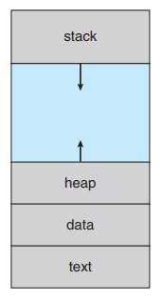
Process Concept
A process is a dynamic entity. It represents a program that has been loaded into memory and is currently being executed by the computer's (CPU), the operating system allocates various crucial resources to it. These resources are essential for the process to perform its designated tasks and include:
Memory Space: This encompasses different segments to hold the program's components:
Code (Text Section): The actual machine instructions of the program, defining what actions the process will take.
Data Section: Storage for global variables and static variables, maintaining data that persists throughout the process's lifetime.
Stack: A region of memory used for managing function calls, local variables within functions, and return addresses. Its dynamic nature allows for efficient handling of function execution
Heap: A region of memory available for dynamic memory allocation during the process's runtime. This allows the process to request and release memory as needed.

Slide 5
Process Concept
CPU Time: The process requires the CPU to execute its instructions. The operating system's scheduler manages how CPU time is allocated among the various running processes.
Input/Output (I/O) Resources: The process might need to interact with peripherals such as the keyboard, mouse, disk drives, or network interfaces. The OS manages access to these resources.
Files: The process may need to read from or write to files stored in the file system.
The Process ID (PID): The Process ID (PID) is a unique identifier assigned to each active process in the operating system. This PID allows the operating system to distinguish between different processes and manage them effectively.
Process State is a key characteristic that distinguishes a process from a mere program. This state reflects the current activity of the process at any given moment. The state changes as the process progresses through its lifecycle. Common states include:
New: The process is in the initial stage of being created.
Ready: The process has been created and loaded into memory and is waiting for its turn to be executed by the CPU.
Running: The process is currently having its instructions executed by one of the CPU cores.
Waiting (Blocked): The process is temporarily suspended, waiting for a specific event to occur, such as the completion of an I/O operation or the receipt of a signal.
Terminated: The process has completed its execution, either normally or due to an error.

Slide 6
Process State
READY
The process is waiting to be assigned to the CPU.
RUNNING
The process is currently being executed by the CPU.
NEW
The process is being created
WAITING
The process is waiting for an event (I/O completion, signal).
TERMINATED
The process a has finished execution.

Slide 7
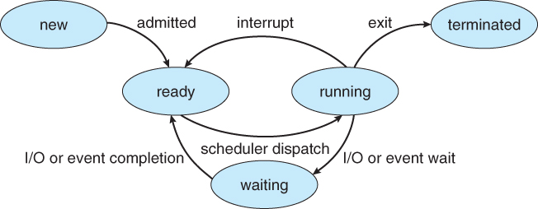
Process State

Slide 8
Process Control Block (PCB)
The operating system maintains a crucial data structure called the Process Control Block (PCB) for every active process within the system. It's the central repository of all information the OS needs to effectively manage and control a specific process throughout its entire lifecycle.
The PCB acts as a container, holding a wealth of information that describes the process's current status, its allocated resources, and its execution context. This information is vital for various OS functions, including scheduling, resource allocation, context switching, and inter-process communication.
Key Information Stored Within the PCB:
Process ID (PID): This is a unique identifier assigned to each active process in the operating system. System calls and utilities often use PIDs to target specific processes for actions like sending signals or terminating execution. Example: In Unix-like systems, commands like ps display PIDs, and kill <PID> uses the PID to send a termination signal.
Process State: This field indicates the current condition of the process during its execution. (new, ready, running, waiting, terminated). The OS uses this state to determine which processes are eligible for CPU allocation.
Program Counter (PC) is a register that holds the memory address of the next instruction that the process will execute. When a process is interrupted and later resumed, the PC ensures that execution continues from the exact point where it left off.

Slide 9
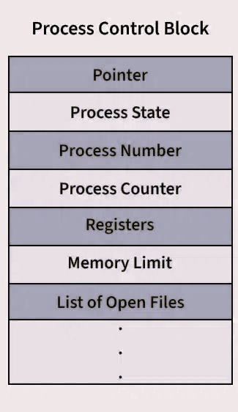
Process Control Block (PCB)
CPU Registers: This section stores the current values of the CPU's registers when the process is not actively running. Saving and restoring the register values during a context switch is crucial for maintaining the integrity of each process's execution. (Accumulators, Index Registers, Stack Pointer, General-Purpose Registers)
CPU Scheduling Information: This field contains information used by the CPU scheduler to determine which process should run. (Priority, Queue Pointers, Scheduling Parameters).
Memory Management Information: This section stores details about the memory allocated to the process. The specific information depends on the memory management techniques used by the OS. (Base and Limit Registers, Page Tables and Segment Tables).
Accounting Information: The OS often tracks the resources consumed by each process for accounting and monitoring purposes.(CPU Time Used, Real Time Used, Time Limits, Account Numbers)
I/O Status Information: This section keeps track of the I/O resources allocated to the process.(Allocated I/O Devices, Open Files)

Slide 10
Threads
Threads are multiple independent streams of instructions that can run concurrently within a single application (process). Imagine a web browser where downloading and displaying a page happen seemingly at the same time, each managed by a separate thread within the browser process. Threads are "lightweight" because they share the main resources of their process (code, data, heap). This sharing reduces the overhead compared to creating new processes. However, each thread has its own essential context for execution:
Thread ID: A unique identifier for each thread within the process.
Program Counter (PC): Keeps track of the next instruction to be executed by that specific thread.
Register Set: A private set of high-speed memory locations used for temporary data storage during the thread's execution.
Stack: A dedicated memory area for managing function calls, local variables, and return addresses for that thread.
Threads are vital for making applications do multiple things at once (concurrency). On computers with multiple processing units (multi-core processors), threads can run truly simultaneously (parallelism), speeding up tasks. Even on single-core systems, they make applications feel more responsive by quickly switching between tasks.
The computer's operating system manages these threads, keeping track of their individual details. A key benefit of using threads within the same application is that they can easily communicate and share information because they use the same memory. However, this shared access requires careful management to avoid problems when multiple threads try to change the same data at the same time.

Slide 11
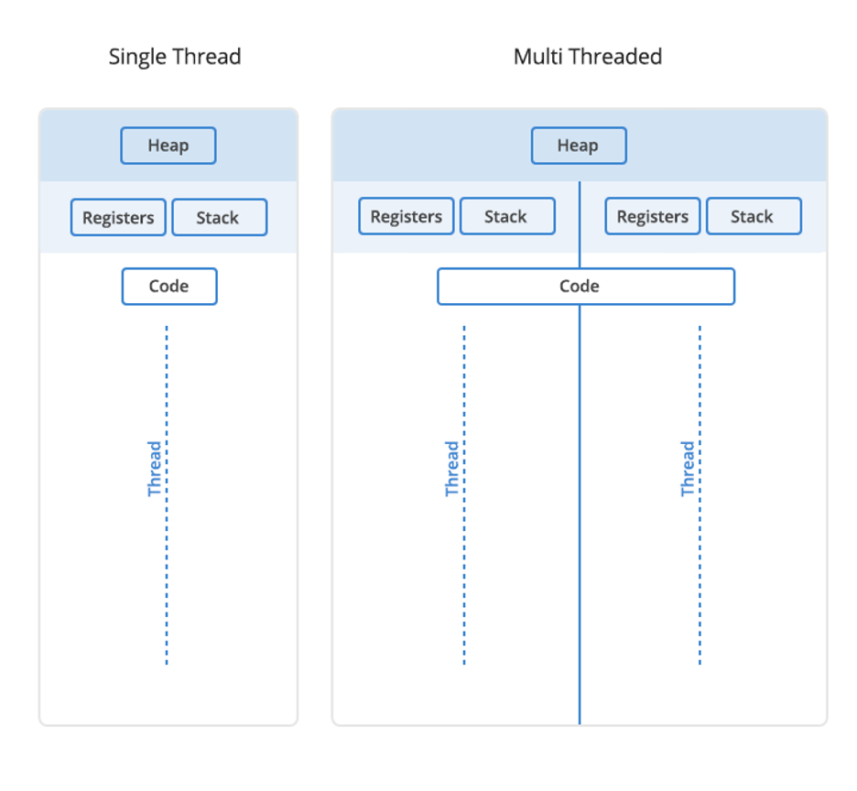
Single Threaded and Multi Threaded Process
Single-Threaded Process: Imagine one worker doing tasks in order. They finish one before starting the next. If a task takes time (like loading a file), the whole process waits. On a multi-core computer, only one core is used. It's simpler to program initially, but the application can freeze and doesn't fully use the computer's power for complex tasks.
Multi-Threaded Process: Think of multiple workers doing different tasks at the same time within the same project. One worker can be drawing, another taking input, and another saving. If one worker has to wait, the others can continue. This makes the application feel faster and more responsive. Multi-core computers can run these workers simultaneously on different cores, using the computer's power better.

Slide 12
Advantage of Multithreaded Programming.
Enhanced Responsiveness: Multithreading prevents applications from freezing during long tasks. By offloading such tasks to background threads, the main UI thread remains active, ensuring a smooth and interactive user experience. Users can continue working even when intensive operations are underway.
Efficient Resource Sharing: Threads within a process share resources like code and data, making it more efficient than inter-process communication. Direct memory access between threads simplifies data exchange and reduces overhead compared to complex IPC mechanisms needed by separate processes.
Economic Resource Utilization: Creating and managing threads is generally less resource-intensive than managing entire processes. Threads are "lightweight," requiring less memory allocation. Context switching between threads is also faster, as less state needs to be saved and restored compared to switching between processes.
Improved Scalability: Multithreading allows applications to leverage the power of multicore processors. By dividing tasks among multiple threads that can run in parallel on different cores, applications can achieve significant performance gains and handle increasing workloads more effectively, fully utilizing modern hardware.
Lower Communication Overheads: Communication between threads within the same process is simpler and faster than between separate processes. Direct access to shared memory reduces the need for complex IPC and minimizes the number of system calls, leading to better performance and more efficient inter-task coordination.

Slide 13
Single Core and Multi Core System
Single-Core Systems
A single-core CPU executes one instruction at a time, simulating concurrency through rapid time-sharing between tasks. This sequential processing can lead to unresponsiveness during lengthy operations. While simpler in design and potentially consuming less power, single-core systems underutilize multi-core processors by only engaging one core. Imagine a lone chef completing each cooking step sequentially, delaying the entire meal if one step takes long.
Multi-Core Systems
Multi-core CPUs integrate multiple independent processing units, enabling true parallel execution of tasks. ¹ Assigning different threads to separate cores improves responsiveness and significantly enhances performance for multithreaded applications. ² These systems utilize available CPU resources effectively, increasing overall throughput. ¹ However, their architecture is more complex, requiring inter-core communication management. ³ While potentially consuming more power, multi-core systems offer better performance per watt for parallel workloads. This is akin to multiple chefs working simultaneously on different parts of a meal, drastically speeding up the preparation.

Slide 14
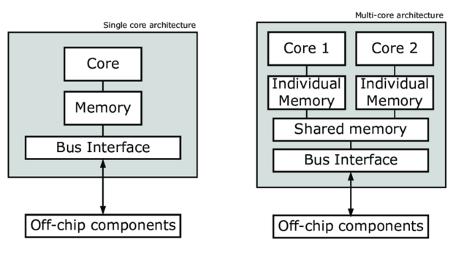
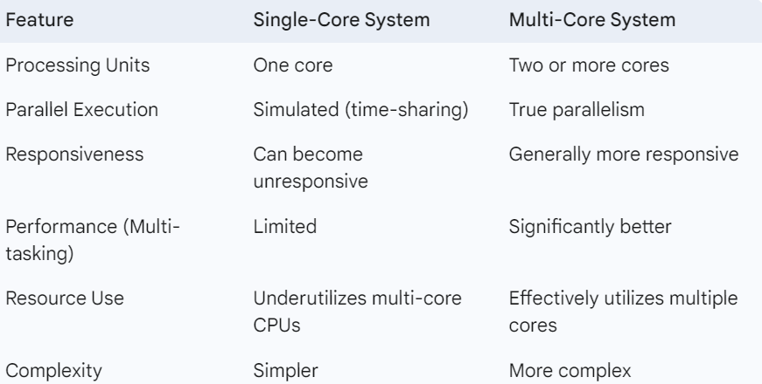
Single Core and Multi Core System

Slide 15
Single Core and Multi Core System
Thread Library: User-Friendly Thread Management
A thread library provides an API (set of functions) for developers to create, manage, and synchronize threads. It acts as an abstraction layer over the OS's threading capabilities. Libraries offer functions for thread creation, termination, synchronization (mutexes, semaphores), scheduling hints, and communication.
Implementations can be user-level (management in user space, faster but limited parallelism, blocking issues) or kernel-level (kernel manages threads, true parallelism, but slower and OS-specific).
Kernel Thread: The OS's Execution Unit
A kernel thread is a fundamental unit of execution directly managed by the operating system kernel. The kernel schedules CPU time for these threads and is fully aware of their state. Kernel threads have direct access to system resources.
Crucially, the blocking of one kernel thread doesn't necessarily halt the entire process, and they enable true parallelism on multi-core systems. User-level thread libraries often rely on underlying kernel threads for actual execution, with different mapping models (one-to-one, many-to-many, many-to-one). The OS also uses kernel threads for its own background tasks. In essence, kernel threads are the OS's basic units for achieving concurrency.

Slide 16
Multithreading Models
Thread Library: User-Friendly Thread Management
A thread library provides an API (set of functions) for developers to create, manage, and synchronize threads. It acts as an abstraction layer over the OS's threading capabilities. Libraries offer functions for thread creation, termination, synchronization (mutexes, semaphores), scheduling hints, and communication.
Implementations can be user-level (management in user space, faster but limited parallelism, blocking issues) or kernel-level (kernel manages threads, true parallelism, but slower and OS-specific).
Kernel Thread: The OS's Execution Unit
A kernel thread is a fundamental unit of execution directly managed by the operating system kernel. The kernel schedules CPU time for these threads and is fully aware of their state. Kernel threads have direct access to system resources.
Crucially, the blocking of one kernel thread doesn't necessarily halt the entire process, and they enable true parallelism on multi-core systems. User-level thread libraries often rely on underlying kernel threads for actual execution, with different mapping models (one-to-one, many-to-many, many-to-one). The OS also uses kernel threads for its own background tasks. In essence, kernel threads are the OS's basic units for achieving concurrency.

Slide 17
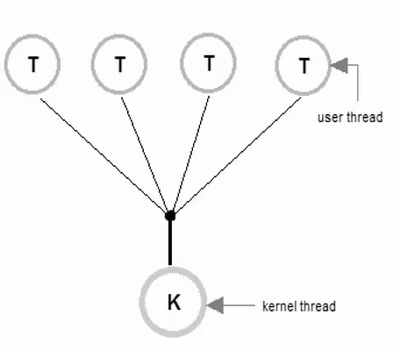
Multithreading Models
Many-to-One Model
Multiple user-level threads are mapped to a single kernel thread. The thread management is done by a thread library in user space. The operating system is unaware of the multiple user-level threads; it only sees a single process with one thread. The user-level thread library schedules the user threads to run on the single kernel thread. This often involves a cooperative scheduling approach where a user thread voluntarily gives up control to allow another user thread to run. Some early implementations of user-level threads, like "green threads," used this model.
Advantages:
Efficient Thread Management
Portability
Disadvantages:
Lack of True Parallelism
Blocking System Calls

Slide 18
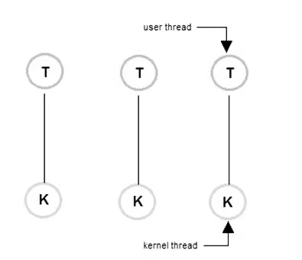
Multithreading Models
One-to-One Model
Each user-level thread is mapped to a corresponding kernel thread. When a user thread is created, a new kernel thread is also created. The operating system's kernel directly manages and schedules each kernel thread. This allows for true concurrency, as multiple kernel threads can run in parallel on multi-core processors. Windows and Linux operating systems commonly use the one-to-one model. Windows and Linux operating systems commonly use the one-to-one model.
Advantages:
True Parallelism
No Blocking Issues
Disadvantages:
Overhead
Resource Consumption

Slide 19
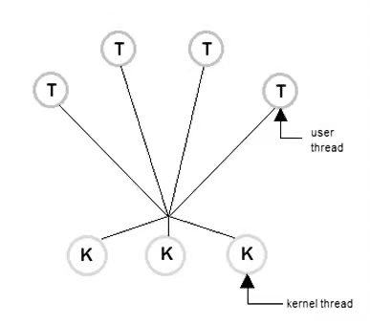
Multithreading Models
Many-to-Many Model
Multiple user-level threads are mapped to a smaller or equal number of kernel threads. The operating system multiplexes the user threads onto the available kernel threads. A thread library manages the mapping between user threads and kernel threads. The number of kernel threads can be dynamic, allowing the operating system to adjust the number of kernel threads based on the application's needs and the available hardware resources. Some older versions of Solaris and IRIX used the many-to-many model. Some modern systems employ variations or hybrid approaches that incorporate aspects of this model.
Advantages:
Balances Parallelism and Overhead
Handles Blocking System
Disadvantages:
Complexity
Potential for Overhead

Slide 20
Operations on Processes
Process Creation: Initiating Execution
Process creation allows a running program (parent) to spawn new, independent programs (children). This hierarchical structure forms a process tree, rooted in the initial system process. The parent-child relationship dictates certain aspects of resource management and control. Each process is uniquely identified by a Process Identifier (PID), crucial for OS tracking and management.
Upon creation, the parent and child can have various levels of resource sharing, ranging from no sharing (independent copies) to partial sharing (e.g., open files). The execution can also be concurrent, or the parent can wait for the child to complete. In UNIX-like systems, the fork() system call duplicates the parent process (often using copy-on-write for efficiency), and the child typically uses exec() to replace its memory space with a new program.
Process Termination: Concluding Execution
A process ends its lifecycle by executing its final instruction and calling the exit() system call, potentially returning an exit status to its parent (retrieved via wait()). The operating system then deallocates all resources held by the terminated process.
A parent process can also prematurely terminate its children using calls like abort() or by sending termination signals (kill() in UNIX), often due to resource limits, task completion, or the parent's own termination. Cascading termination ensures that when a parent terminates, all its children are also terminated, preventing orphaned processes. The wait() system call allows a parent to pause its execution until a child finishes, retrieving its exit status.
Terminated processes can exist in special states: zombies, where the process has exited but its process table entry remains until the parent calls wait(); and orphans, where the parent has terminated, and the child is adopted by a system process (like init or systemd) for eventual cleanup.

Slide 21
Process Types
Foreground Process: Active, user-facing applications with visible interfaces. They receive direct user input (keyboard, mouse) and display output on the screen. The user has direct control and often prioritizes their resources for responsiveness. Examples include the active window of a word processor or a web browser.
Background Process: Processes running without direct user interaction, performing tasks behind the scenes. They don't typically interact with the active display and might use files or network connections for input/output. Examples include downloading files or printing. They often have lower priority than foreground processes.
Service Process (Daemon): Specialized background processes providing essential OS or application functionalities. They often start automatically and run continuously, listening for requests and performing tasks without direct user interfaces. Examples include web servers, database servers, and print spoolers.
Batch Process: Processes executing a series of tasks automatically without user intervention during runtime. Input and output are usually through predefined files or streams. They are often scheduled for off-peak hours for tasks like data processing or backups.
Interactive Process: Processes requiring user input to proceed, though they might not be the currently focused application. They engage in a dialogue with the user through terminals or dialog boxes, waiting for specific input to continue execution, like command-line tools prompting for parameters.
Zombie Process: Terminated processes that still have an entry in the process table, holding exit status for the parent. They consume minimal resources but need the parent to acknowledge their termination via a wait() system call to be fully removed.
Console Process: Processes running within a command-line interface or terminal emulator. They interact with the user through text-based commands and output displayed in the terminal. Examples include shell commands and text-based editors.

Slide 22
CONCLUSION
In summary, this presentation has provided an overview of process management, highlighting its importance in modern operating systems. We've examined the differences between single and multi-threaded processes, showcasing the advantages of multithreading in terms of responsiveness, resource sharing, and scalability. We also explored single-core and multi-core systems and how they handle processes. Finally, we discussed thread libraries, kernel threads, multithreading models, process creation, and termination, emphasizing the operating system's role in effectively managing these fundamental aspects of computing.

Slide 23

Thank you for listening
202322240334
202322240355
202322240364
The user can demonstrate on a projector or computer, or print the presentation and make it film

